Slide 1
GreenSheets Recommendations
Presented on: 08-June-2016

Slide 2
Project scope
Fix recurring production issues
Greensheets Submission (Major reoccurring issue (PD Greensheet)
Greensheets Timeout (Major reoccurring issue)
Duplicate greensheets (only reoccurring occasionally)
Accommodate business needs:
Tech stack upgrade
UI modernization and usability
Provide reporting capabilities
Ad-hoc reports on statistics related to answers to a specific question
User-friendly dashboard report to easily access the grants and the underlying greensheets and also to help visualize some of the key metrics.
Enhance search capabilities
Enhance security
UI modernization and usability
Using additional capabilities of Form Builder
Changes to business flow and navigation
Compliance document retention policy

Slide 3
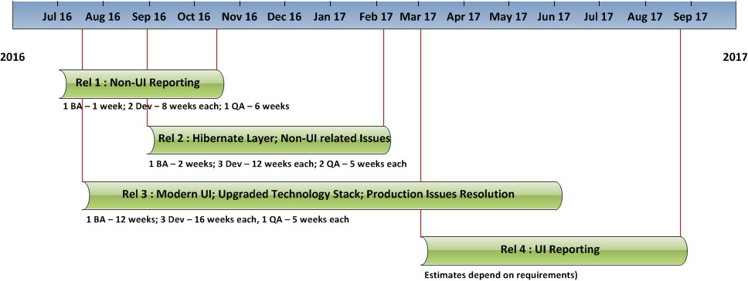
Possible project chart and resource allocation
Notes
The resource allocation indicates optimal number of developers working on a project
Project duration can be shortened by adding additional QA and Dev resource to the release 3
Release 4 is optional if OGA use other tools for reporting purposes

Slide 4
High level list of recommendations for re-design
# | Recommendations | Description
1 | Non UI reporting | Modify Greensheets database so it will allow run ad-hoc reports on statistics related to answers to a specific question on demand. Design and implement new schema to store questions and other objects needed for reporting Database migration
2 | Upgrade technology stack | Hibernate transactional framework Struts 2 MVC framework Modern front-end frameworks like Bootstrap, JQuery, CSS, etc.
3 | UI re-design | Search functionality re-design (must) Greensheets submission issue – address usability (must) Help system re-design Navigation and business flow enhancements (possible) Overall look and feel re-design to make it consistent with other NCI systems Solutions to issues related to multiple open windows 508 compliance
4 | Roles’ re-design | Diversity supplement director Guest user Super User Possible changes to roles related to promotion/rejection of draft templates
5 | UI reporting | The system will allow users to enter search parameters and run ad-hoc reports on statistics related to answers to a specific question in specified output format Dashboard report (graphic visualization): The system will provide a user-friendly dashboard report to easily access the grants and the underlying Greensheets and also to help visualize some of the key metrics. These are “house-keeping” reports, for example ‘how many greensheets in Submitted status.

